Slide 1
A Framework for Learning Analytics Data and Indicator Quality (LADIQ)
Séminaire MOTEL
15/12/2025
Fahima Djelil et Nadine Mandran
Poster soumis à LAK 2026

Slide 2
Background
Data Quality Criteria and Assessment Phases
Data Quality Criteria
Many classifications have been proposed to define a basic set of data quality dimensions (Batini et al., 2009).
We have selected five key criteria :
Accuracy, refers to the extent to which the data are correct, reliable, and certified;
Completeness, which is often related to missing values in a dataset;
Consistency, refers to the absence of conflicting information in the data;
Timeliness, refers to the updating of data over time;
Intelligibility, which means that the data is easily accessible, understandable, and interpretable without ambiguity.

Slide 3
Background
Data Quality Criteria and Assessment Phases
Data Quality Assessment phases
We propose assessing these criteria in four phases throughout data collection and preparation for producing indicators (Berti-Equille, 2004) :
Preventive phase : for data quality assessment, which occurs before data production;
Adaptive phase: occurs during data production;
Diagnostic phase: occurs after data collection, verifying the correctness and compliance of real-world data,
Corrective phase: occurs after data collection, cleaning the data by removing missing information or duplicate entries.

Slide 4
Background
Indicator Quality Criteria and Dimensions
Exiting quality indicators in the literature
We have selected existing quality indicators from the literature, regarding direct assessments of academic performance, focusing on learning and teaching processes (De Landsheere, 1994).
We have proposed classifying them according to a hierarchical framework for data quality (Wang & Strong, 1996).
We define a LA indicator as a measure resulting from the processing of initial data that reports significant features.

Slide 5
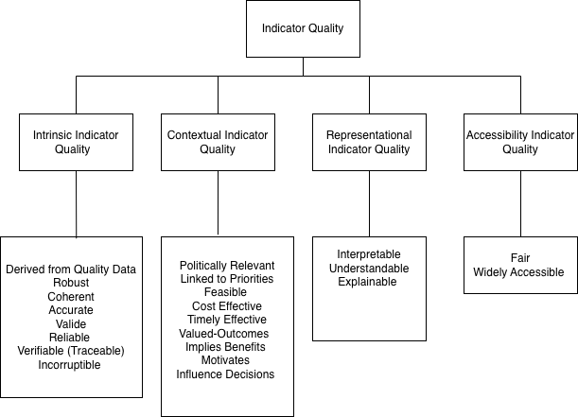
Background
Indicator Quality Criteria and Dimensions
A quality indicator should be:
intrinsically valid,
contextually appropriate,
clearly represented and,
accessible to educational practitioners.

Slide 6
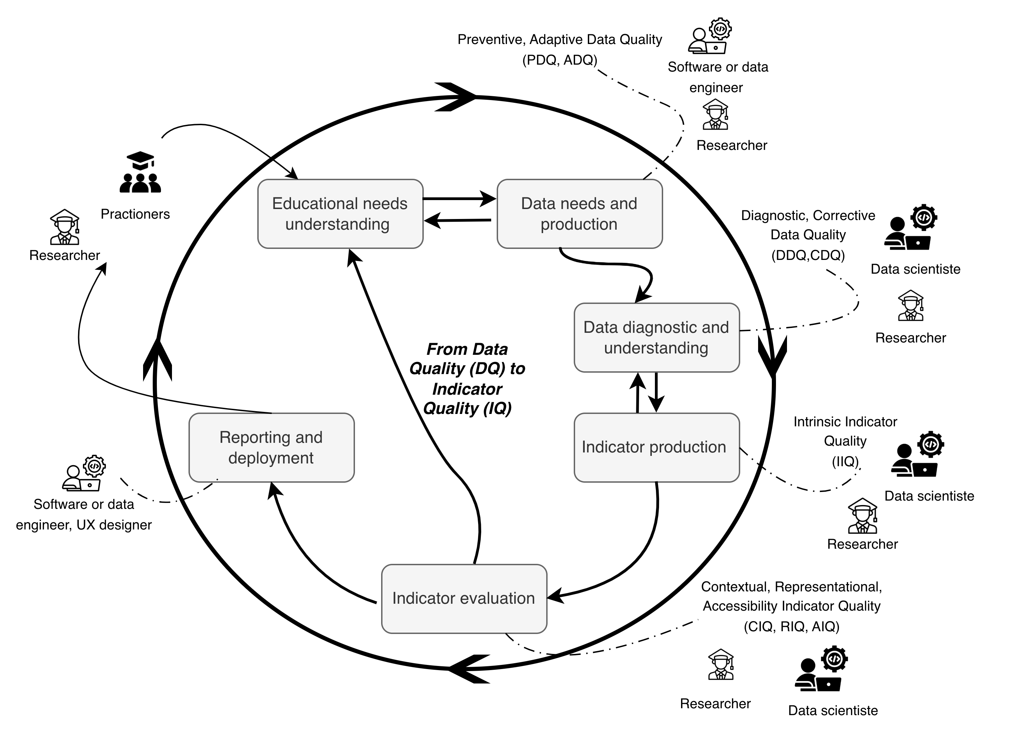
LADIQ Framework
Adapting the CRISP-DM Framework
LADIQ is based on the framework CRISP-DM (Chapman et al., s. d.), by adapting it to LA data production and indicator development while ensuring data and indicator quality.

Slide 7
Conclusion
1
2
3
The LADIQ framework highlights the different phases of data and indicator production, as well as the most frequent dependencies between them and the key stakeholders involved
outlines the data quality dimensions and assessment stages that are integrated throughout the design process
potential to guide the design of LA indicators that must remain accurate and relevant in a real educational context
Future work : assess its relevance and potential as a methodological guide for designing quality indicators based on quality data for learning analytics.
Titre du document / Date

Slide 8
References
Batini, C., Cappiello, C., Francalanci, C., & Maurino, A. (2009). Methodologies for data quality assessment and improvement. ACM Computing Surveys, 41(3), 1‑52.
Berti-Equille, L. (2004). Un état de l’art sur la qualité des données. Ingénierie des systèmes d’information, 9(5‑6), 117‑143.
Chapman, P., Clinton, J., Kerber, R., Khabaza, T., Reinartz, T., Shearer, C., & Wirth, R. (2000). Step-by-step data mining guide.
Chatti, M. A., Muslim, A., Guliani, M., & Guesmi, M. (2020). The LAVA Model : Learning Analytics Meets Visual Analytics. In D. Ifenthaler & D. Gibson (Éds.), Adoption of Data Analytics in Higher Education Learning and Teaching (p. 71‑93). Springer International Publishing.
G De Landsheere. 1994. Le pilotage des systèmes d’éducation, bruxelles, de boeck université, coll. Pédagogies en développement.
Wang, R. Y., & Strong, D. M. (1996). Beyond Accuracy: What Data Quality Means to Data Consumers. Journal of Management Information Systems, 12(4), 5‑33.

